Slide 1
Signal Dispersion

Slide 2
Concept:
Material Dispersion: This occurs because the refractive index of glass varies with the wavelength of light.
Since an LED light source isn't "pure" (it contains a range of wavelengths/colors), different colors travel at different speeds through the fiber.
Pulse Broadening: As these different speeds cause parts of the light pulse to arrive at different times, the pulse "spreads out" or broadens as it travels.
Intersymbol Interference (ISI): For CSE students, the practical impact is ISI. If a pulse broadens too much, it starts overlapping with the pulse representing the next bit.
The receiver then cannot distinguish between a "1" and a "0".

Slide 3
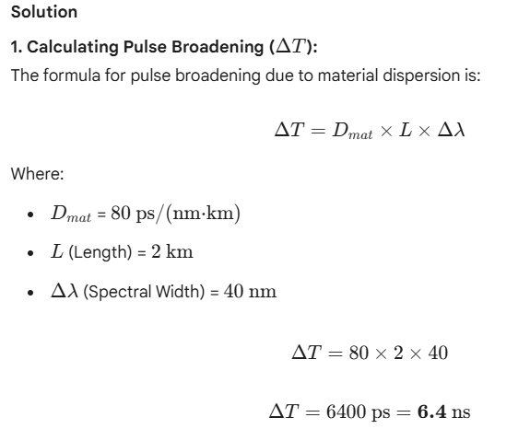
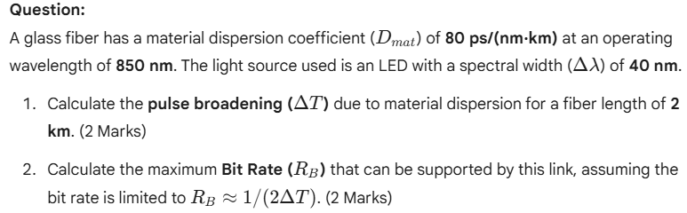
Exercise: Material Dispersion and Pulse Broadening

Slide 4
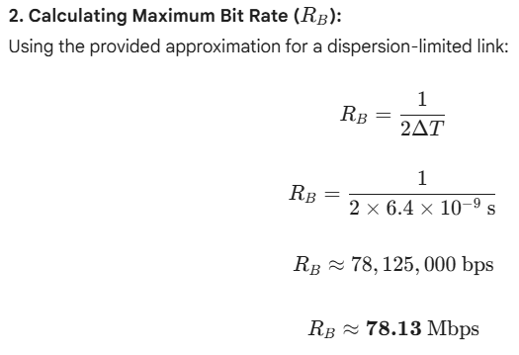
Exercise: Material Dispersion and Pulse Broadening

